Slide 1
Diabetes Prediction Using Machine Learning
A Data Science Project
Presented by: Group 14
PRATEEK KUMar
SAGAR SRIVASTAVA
SATWIK SHAW
SAMARTH SHUKLA
SATYAM TIWARI

Slide 2
Introduction
Diabetes is a chronic disease that affects millions globally.
Early diagnosis and management are critical to reduce health risks.
This project uses machine learning to predict the likelihood of diabetes based on health data.

Slide 3
Problem Statement
Can we accurately predict whether a person has diabetes using medical data?
Objective: Build a classification model using a dataset of patient records.

Slide 4
Dataset Description
• Dataset: Pima Indians Diabetes Dataset
• Total records: 768
• Features include:
- Pregnancies, Glucose, Blood Pressure
- Skin Thickness, Insulin, BMI
- Diabetes Pedigree Function, Age
• Target variable: Outcome (0 = No diabetes, 1 = Diabetes)

Slide 5
Data Preprocessing
• Handled missing values implicitly by model (zeros as indicators)
• Split dataset into training (80%) and test (20%) sets
• Features were scaled using StandardScaler

Slide 6
Model Selection
• Chosen Model: Random Forest Classifier
• Reason: Robust to noise, handles non-linear data well, and provides feature importance

Slide 7
Marketing strategies
Implement personalized engagement strategies
Tailor campaigns to resonate with specific demographics, fostering a sense of relevance and connection
Collaborate with influencers and thought leaders to amplify our brand message

Slide 8
Model Training
• Used Scikit-learn library to train the model
• Hyperparameters were kept at default for baseline evaluation

Slide 9
Evaluation Metrics
• Accuracy: 72%
• Precision (Class 0): 0.79
• Precision (Class 1): 0.61
• F1-Score (Class 0): 0.78
• F1-Score (Class 1): 0.61

Slide 10
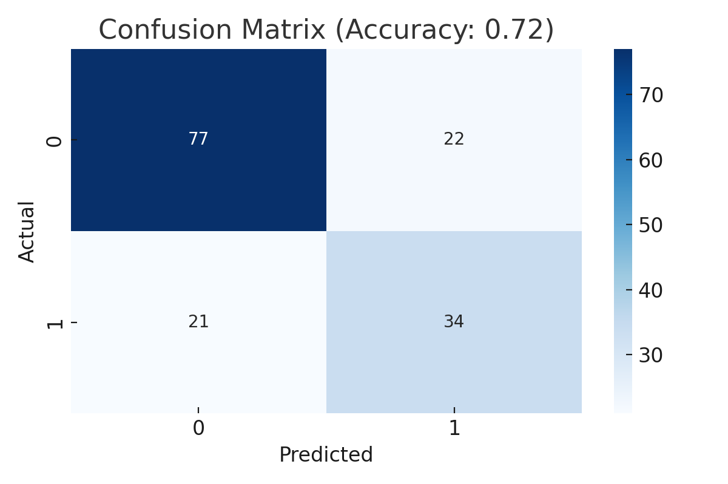
Confusion Matrix :

Slide 11
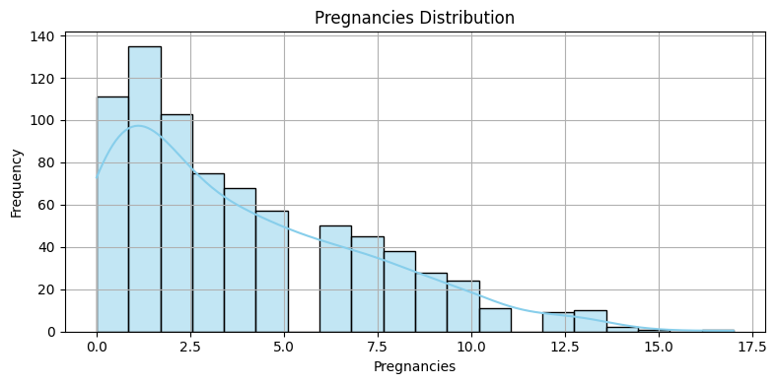
Screen Shots

Slide 12
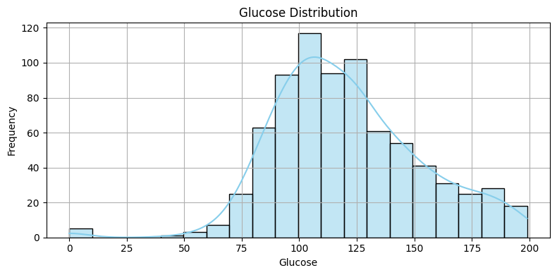

Slide 13
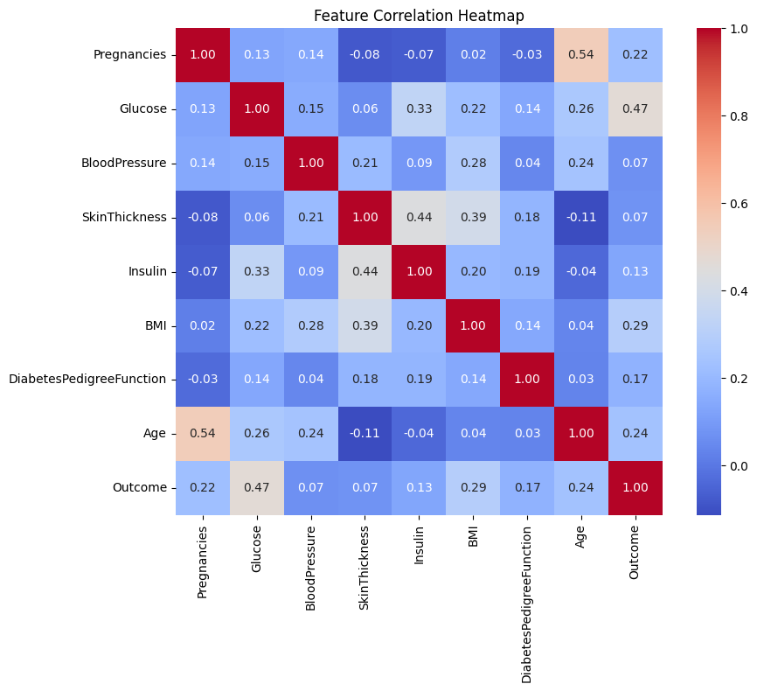

Slide 14
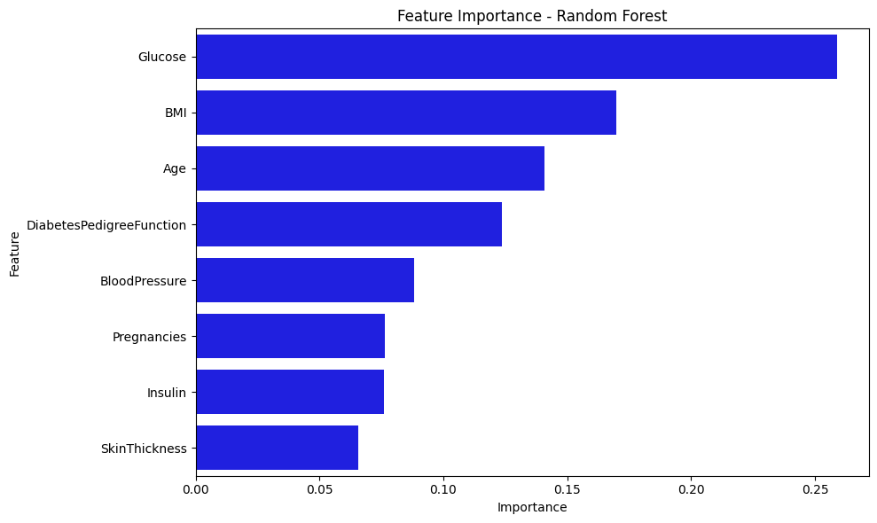

Slide 15
Conclusion
• The Random Forest model achieved a good baseline accuracy of 72%
• Model performs better on non-diabetic predictions
• Future work: try other models, handle zero values more carefully, tune hyperparameters

Slide 16
Challenges
• Presence of zero values in medical features (e.g., Insulin)
• Imbalanced class distribution
• Limited data for high precision modeling

Slide 17
Future Work
• Hyperparameter tuning and feature engineering
• Test more models (Logistic Regression, SVM, XGBoost)
• Use oversampling or undersampling to handle class imbalance

Slide 18
References
1. UCI Machine Learning Repository
2. Scikit-learn Documentation
3. Matplotlib & Seaborn Libraries
4. Pima Indians Diabetes Dataset

Slide 19
THANKYOU !!

